Slide 1
Computer Vision Applications with ModelArts
Building and Deploying Image Classification & Object Detection Models
Using Convolutional Neural Networks (CNNs) on Huawei ModelArts
Presented by: Qazi Adil & Syed Munawar Shah
Dated: 10.08.2025

Slide 2
Agenda
1. Introduction to Computer Vision
2. What is Huawei ModelArts?
3. Understanding CNNs
4. Image Classification with ModelArts
5. Object Detection with ModelArts
6. Dataset Preparation
7. Model Training Process
8. Model Deployment
9. Real-World Use Cases
10. Summary & Q/A

Slide 3
Introduction to Computer Vision
Computer Vision (CV) enables machines to interpret images and videos.
Applications: facial recognition, self-driving cars, medical imaging, security.
Tasks: classification, detection, segmentation.

Slide 4
What is Huawei ModelArts?
A one-stop AI development platform by Huawei.
Supports data processing, model building, training, and deployment.
No-code, low-code, and pro-code support.
Integrates with Ascend AI chips and OBS.

Slide 5
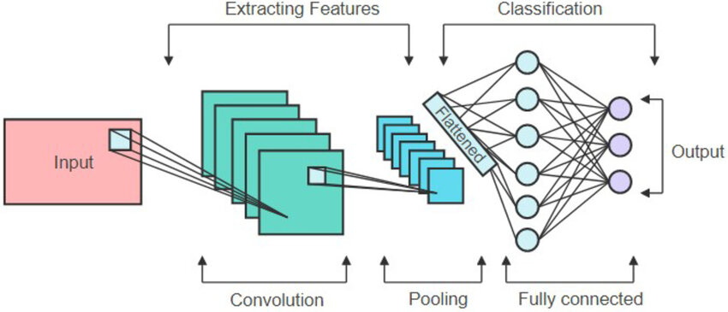
Understanding CNNs (Convolutional Neural Networks)
CNNs are specialized neural networks for visual data.
Layers: Convolution, Pooling, Fully Connected, Activation.
Learn spatial hierarchies from images.

Slide 6
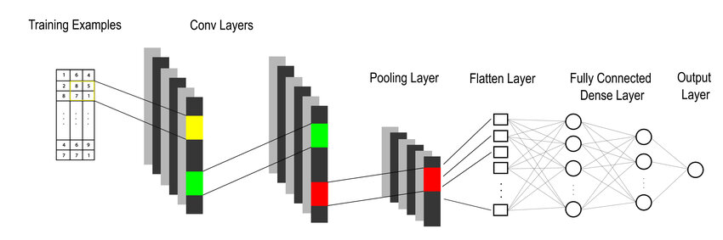
Image Classification with ModelArts
Choose built-in classification model or custom code.
Upload dataset to OBS (Organized in class folders).
Use AutoML or custom training script.
Output: class label for input image.

Slide 7
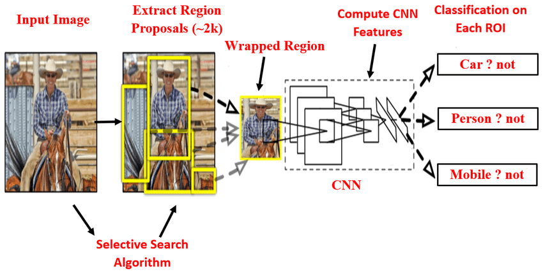
Object Detection with ModelArts
Identify and locate multiple objects in an image.
Use pre-trained models (e.g., Faster R-CNN, YOLO) or custom models.
Requires annotated images (bounding boxes).
Output: object labels + location.

Slide 8
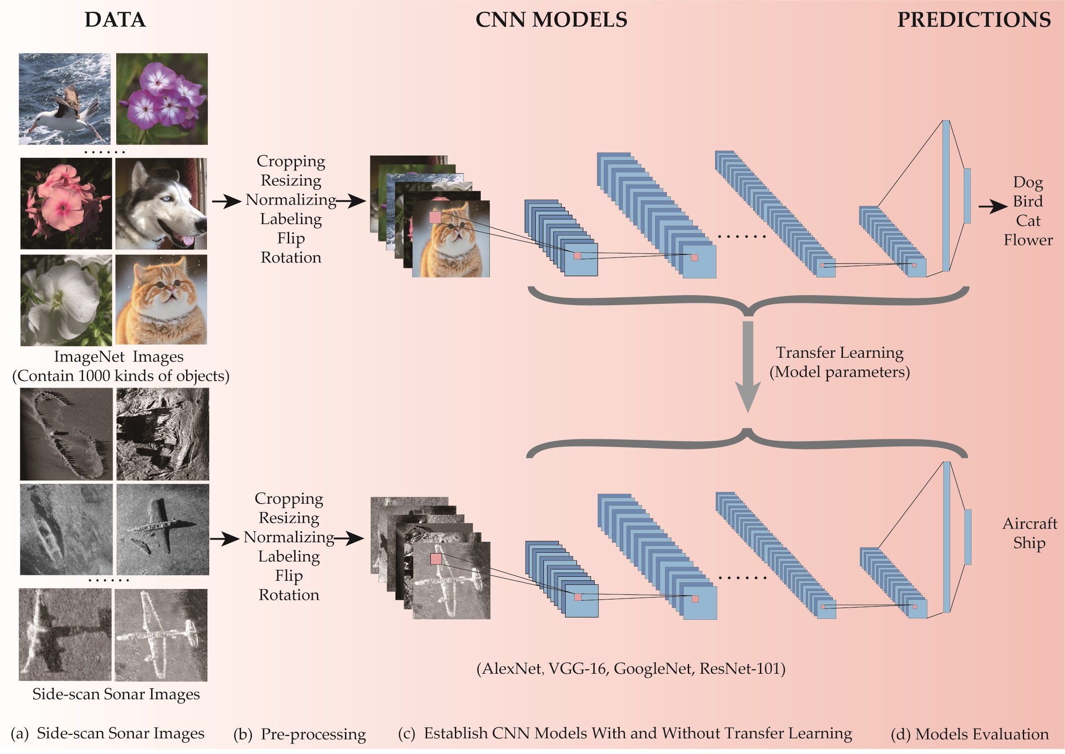
Dataset Preparation
Format for classification: /class1/image1.jpg, /class2/image2.jpg...
Format for detection: VOC/COCO annotations.
Tools: LabelImg for annotation, OBS for storage.

Slide 9
Model Training Process
Create training job on ModelArts.
Select algorithm/framework (e.g., TensorFlow, PyTorch).
Configure parameters (learning rate, epochs).
Monitor metrics: accuracy, loss.
Evaluate model performance.

Slide 10
Model Deployment & Use Cases
Deploy as an endpoint using ModelArts.
REST API for real-time prediction.
Use Cases:
Smart surveillance
Medical diagnostics
Quality inspection in manufacturing
Wildlife monitoring

Slide 11
Summary & Q/A
CNNs enable powerful image classification & detection.
ModelArts simplifies the AI workflow from training to deployment.
Ideal for both beginners and professionals.
Questions?

Slide 12
Thank You

